Slide 1
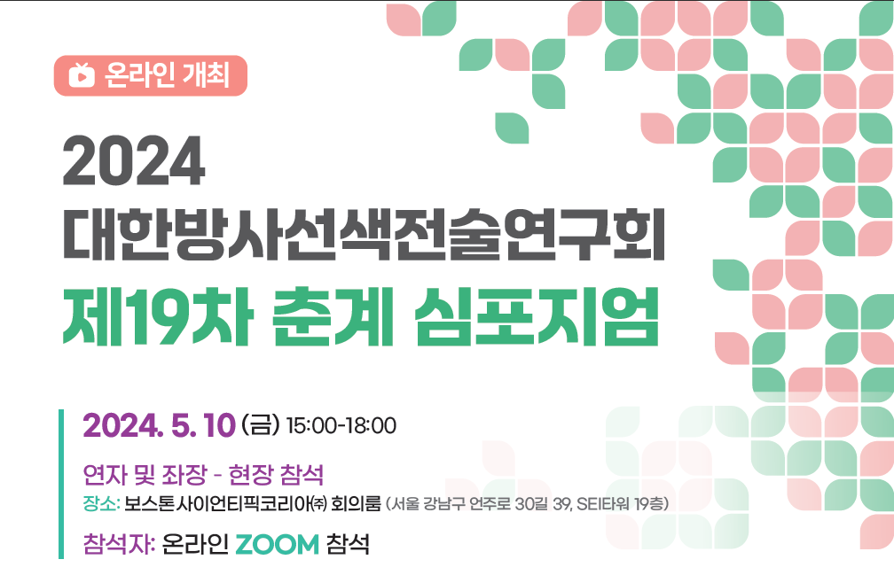


Korea-Taiwan
TARE Joint Workshop
2024. 12. 27 (Fri) 16:30~
LAHAN hotel Jeonju
(Session 1) Indications, Outcomes, Personalized Dosimetry
(Session 2) Real-World Applications of TARE

Slide 2

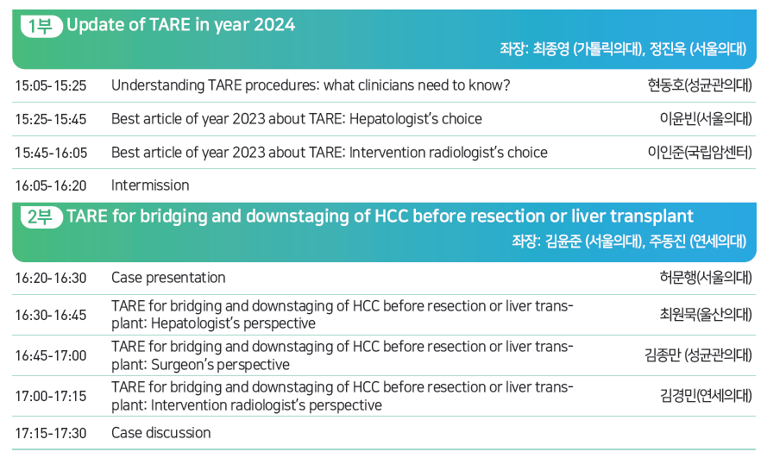
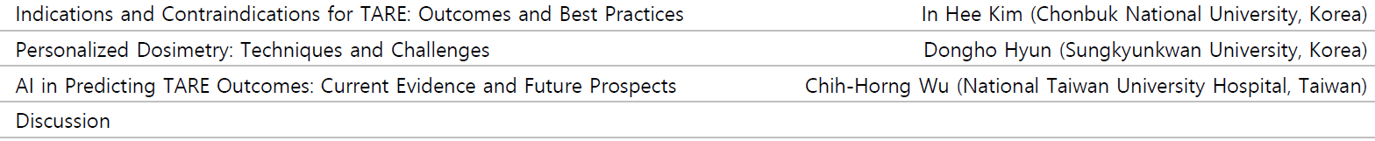
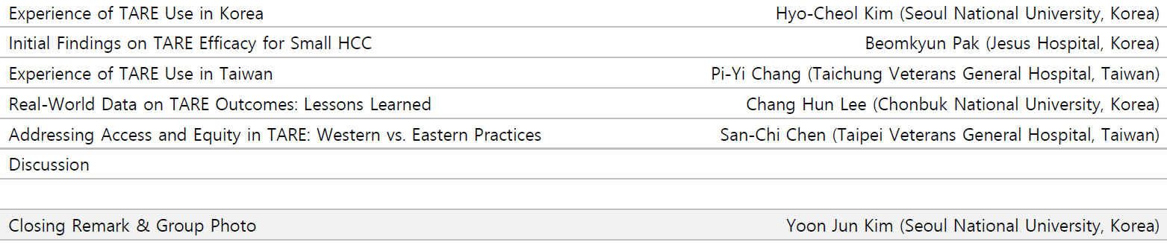
Program
Session 1
Session 1
Indications, Outcomes, and Personalized Dosimetry in TARE for HCC
Session 2
Real-World Applications of TARE: Insights from Global Clinical Practice

Slide 3

Session 1: Indications, Outcomes, and Personalized Dosimetry in TARE for HCC
Yun Hwan Kim (Jesus Hospital, Korea)
Rheun-Chuan Lee (Eonway Health Management Center, Taiwan)

Slide 4
Session 2: Real-World Applications of TARE: Insights from Global Clinical Practice
Yoon Jun Kim (Seoul National University, Korea)
Yu-yun Shao (National Taiwan University Hospital, Taiwan

Slide 5
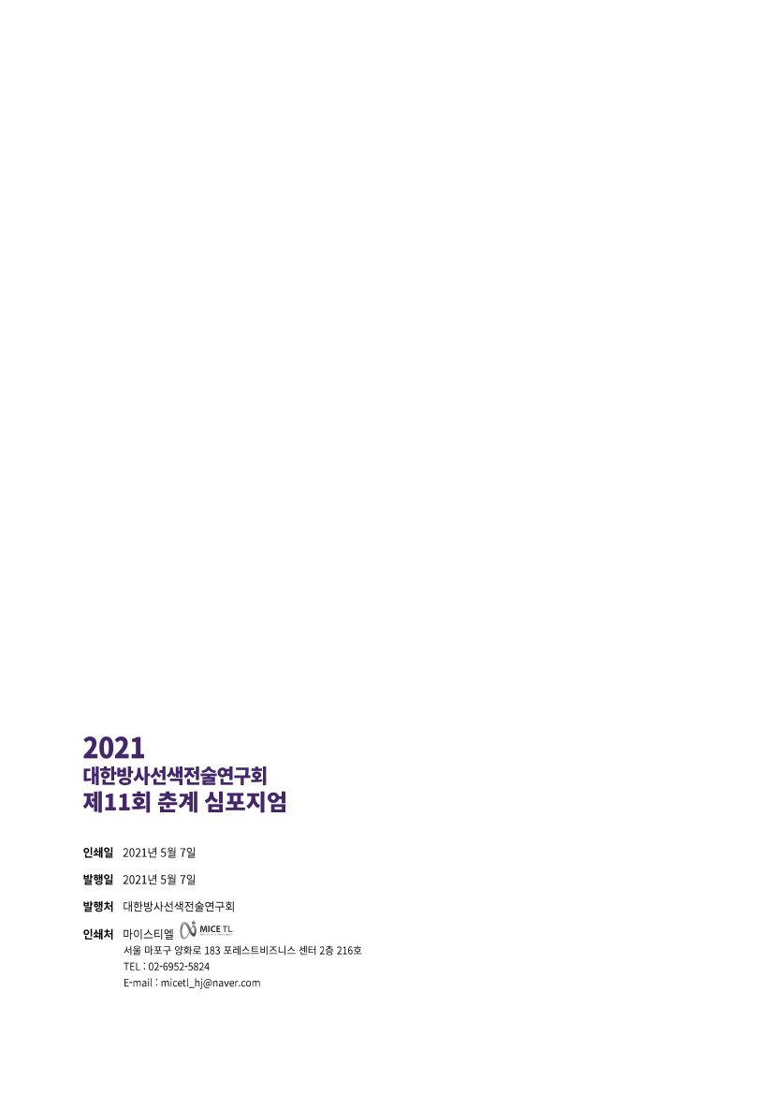
2024
The Korean Radioembolization Association Webinar
Date: 2024-12-27
Copyright © 2024 by Korean Radioembolization Association, Korean Liver Cancer Association (KLCA)
1527 Gangnam Finance Plaza, 419 Teheran-ro, Gangnam-gu, Seoul 06160, Korea
Tel: +82-2-313-1900
E-mail: klca@livercancer.or.kr

