Slide 1

Noticeable articles of year 2022 about TARE: Interventional Radiologist’s choice
Jung Suk Oh
Department of Radiology
Catholic University of Korea
Seoul St. Mary’s Hospital

Slide 2
Overview of articles
TARE for hepatic metastasis
TARE for HCC
TARE combined with chemotherapy
Dosimetry

Slide 3
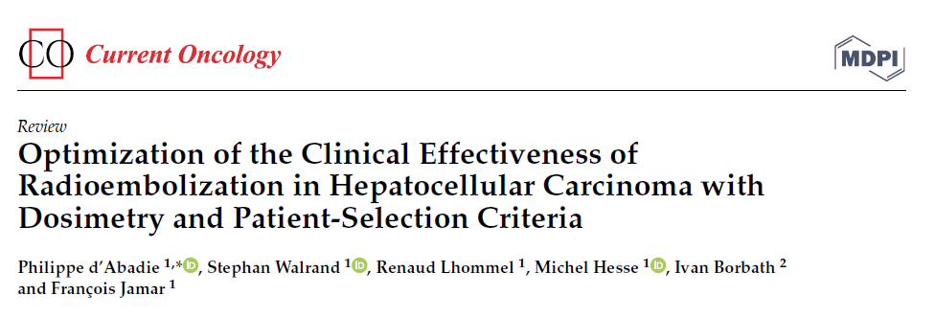
Review article
  Clinical Results of SIRT in HCC
  Clinical Dosimetry in SIRT
  Personalized Dosimetry in SIRT
  Good HCC Candidates for SIRT

Slide 4
Clinical Results of SIRT in HCC
  SIRT, alternative treatment for patients with BCLC A,B,C
  BCLC stage A : very efficient to unresectable solitary HCC alone or for use as a neoadjuvant bridge in a curative surgical approach
  BCLC stage B: similar survival outcomes with cTACE, longer TTP
  BCLC stage C : randomized controlled trials comparing SIRT to sorafenib have failed to demonstrate a superior outcome with SIRT

Slide 5
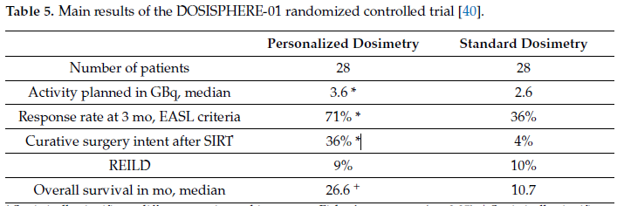
Personalized Dosimetry in SIRT
  recommended activity prescription can induce suboptimal absorbed doses to tumors
  At least 205 Gy to tumors (>250 Gy if possible) was used, the clinical outcome was highly improved as compared to patients treated with the standard (120 Gy to the targeted liver) dosimetric approach

Slide 6
Optimization of Tumor Targeting
  splitting the activity among multiple injections
  for the different arterial branches of the tumor with small microcatheters
  Use CBCT
  Use anti-reflux catheter
  Vasoconstrictor(angiotensin II)
  Vasodilator(dopexamine)

Slide 7
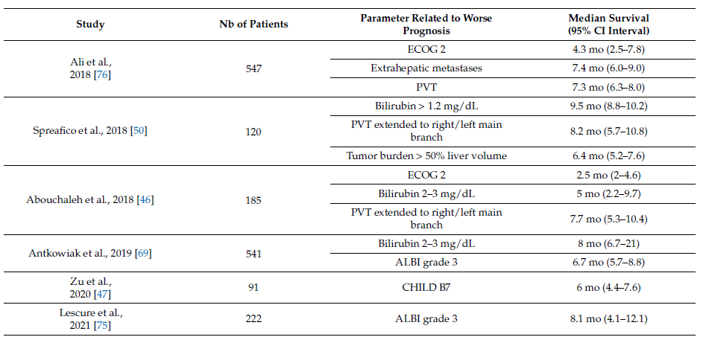
Good HCC Candidates for SIRT

Slide 8
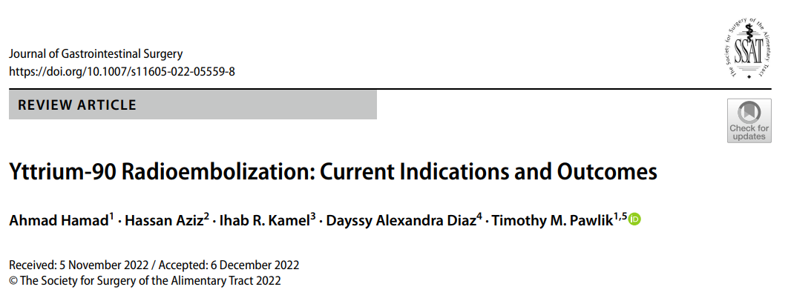
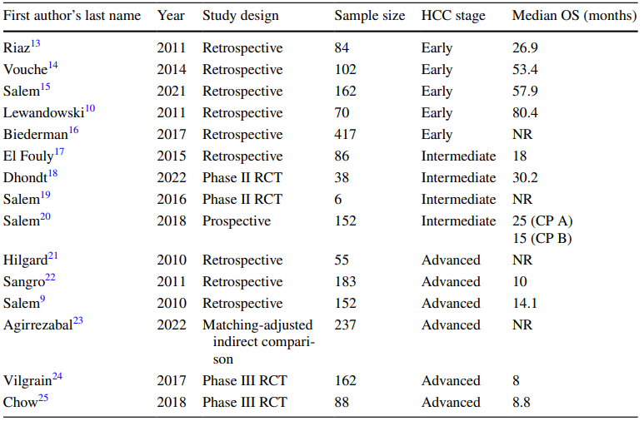

Slide 9
OS, TTP
BCLC A : LT, resection > radiation segmentectomy = RFA > cTACE
BCLC B : Radioembolization > cTACE
superior safety profle
better tolerated the treatment
fewer hospitalizations and treatment sessions
BCLC C : Radioembolization = sorafenib
Best option of inoperable pt.

Slide 10
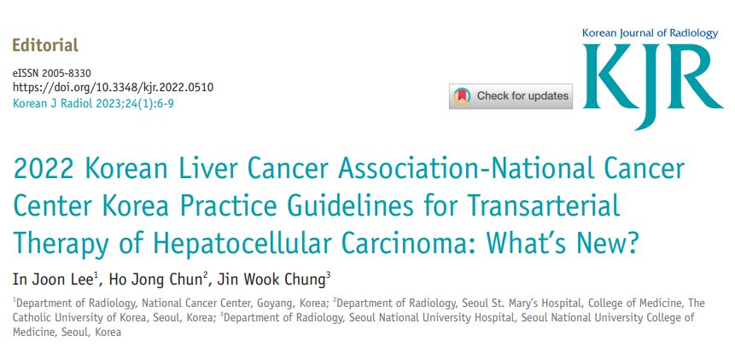
TARE as an Alternative Treatment to cTACE
TACE and TARE as First-Line Treatments

Slide 11
TARE as an Alternative Treatment to cTACE
Current research outcomes of personalized dosimetry suggest potential improved therapeutic benefits of TARE over cTACE
A significantly higher cost
Good candidates : older patients, patients with poor performance status or severe comorbidities, or patients with large tumor
R emnant liver function after the procedure should be carefully evaluated (radioembolization-induced liver disease)

Slide 12
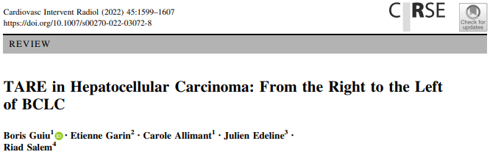
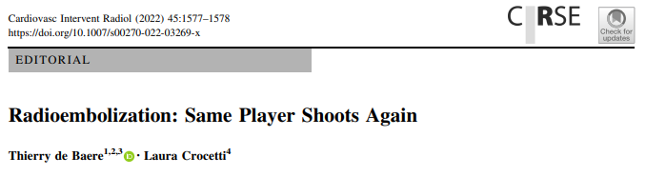

Slide 13
Thank you for listening.

