Slide 1


TARE is the first-line option
Hyo-Cheol Kim, M.D.
radioembolization@snu.ac.kr
angiointervention@gmail.com
Clinical Professor
Department of Radiology
Seoul National University Hospital
Notes:
Good morning, ladies and gentlemen
I’d like to talk about ~~~~

Slide 2
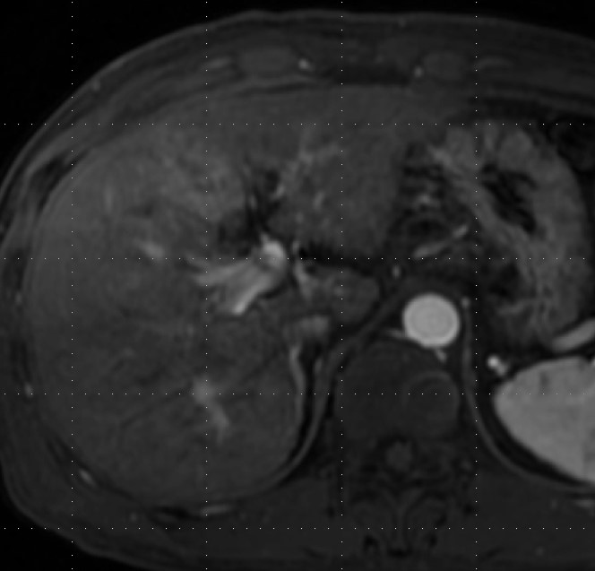
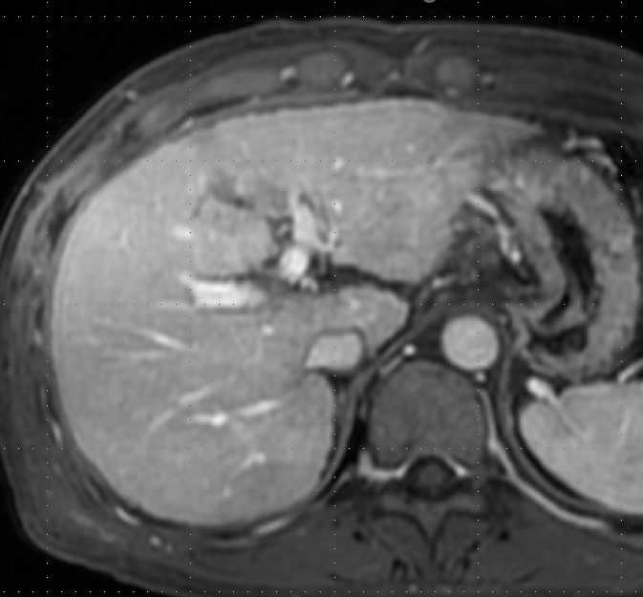
Locally advanced HCC with minor PVI
4.5cm HCC with segmental PVT in Child-Pugh A5 ➔ TARE
TARE procedure : boosted dose in A4
prn half/regular dose in A5, A8, LH artery

Slide 3
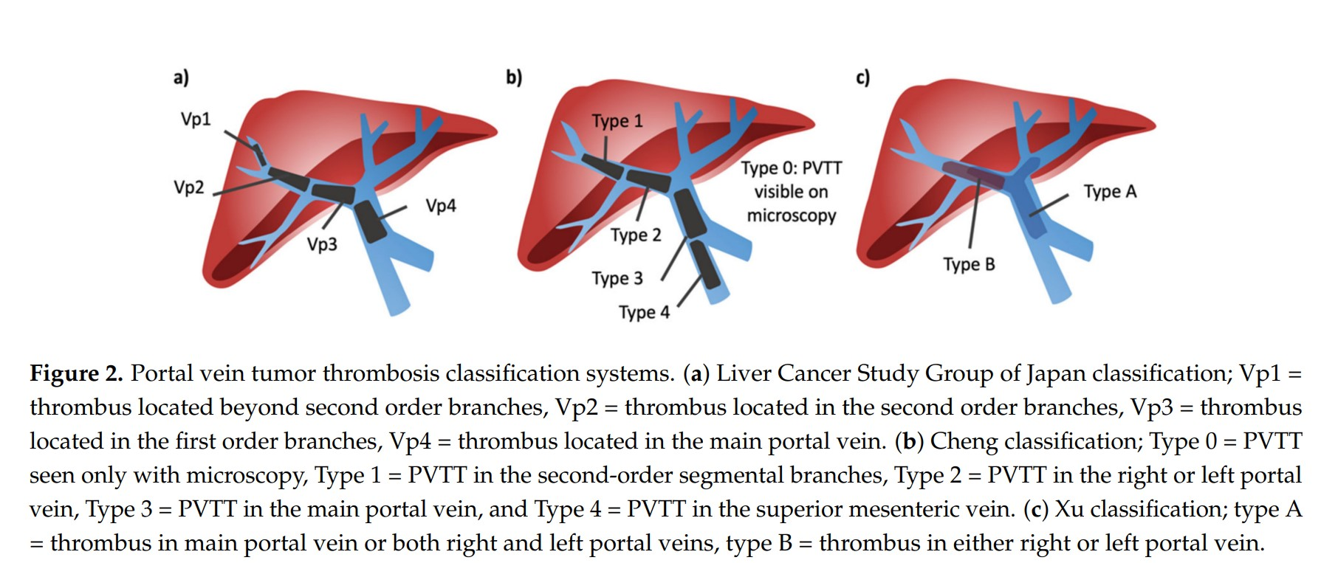
PVT classification
Minor PVT : Vp1 or Vp2
Type 1

Slide 4
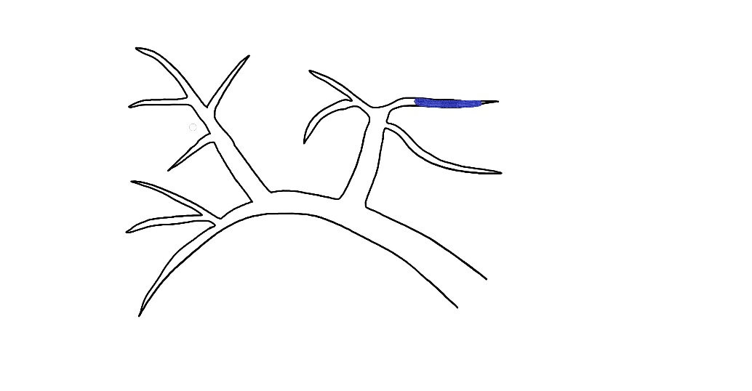
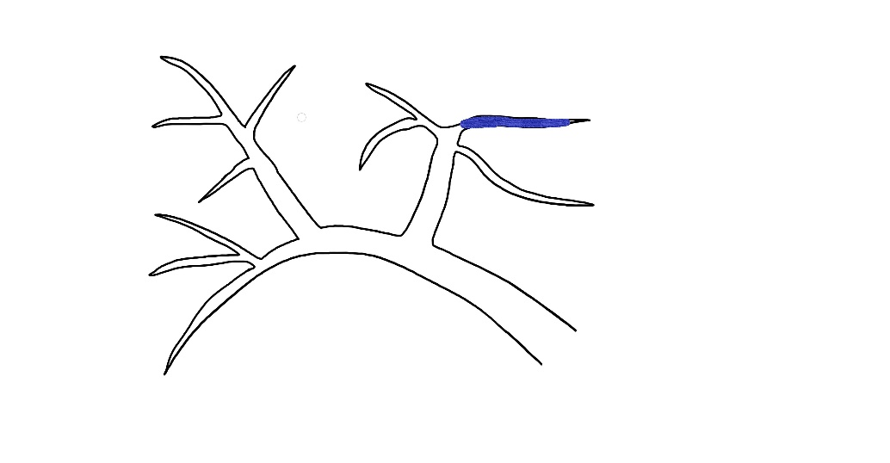

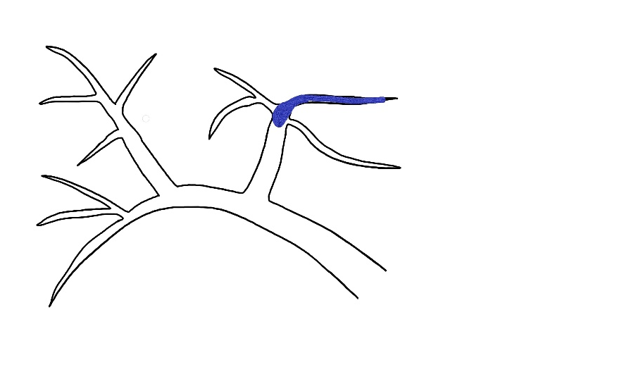
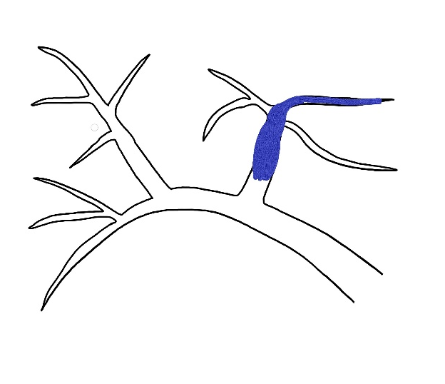
Vp2
Type 1
Vp2
Type 1
Vp3
Type 2
Vp3
Type 2
Vp3
Type 2

Slide 5
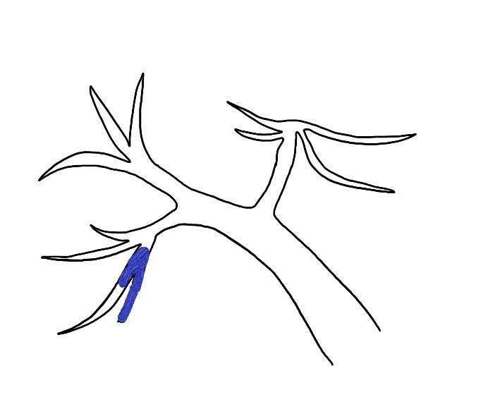
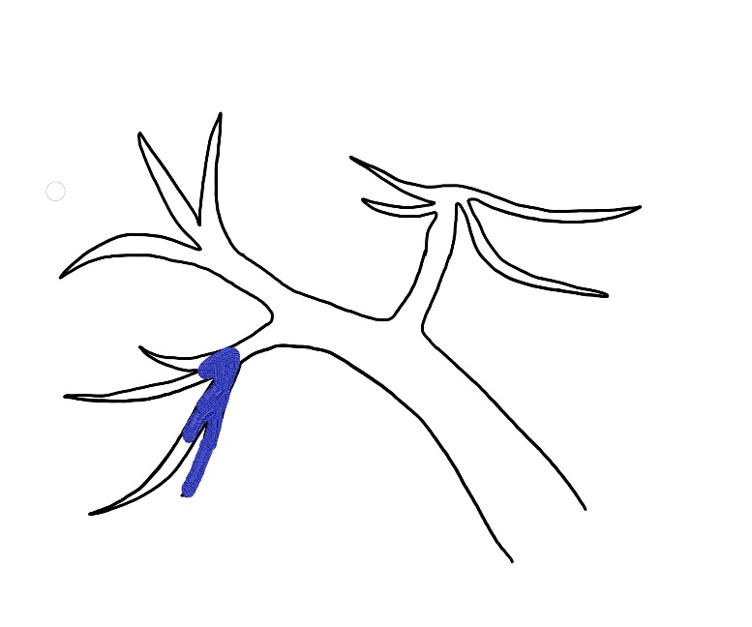
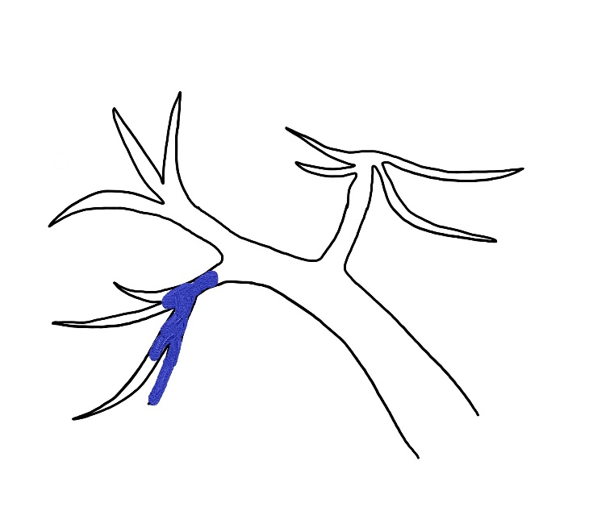
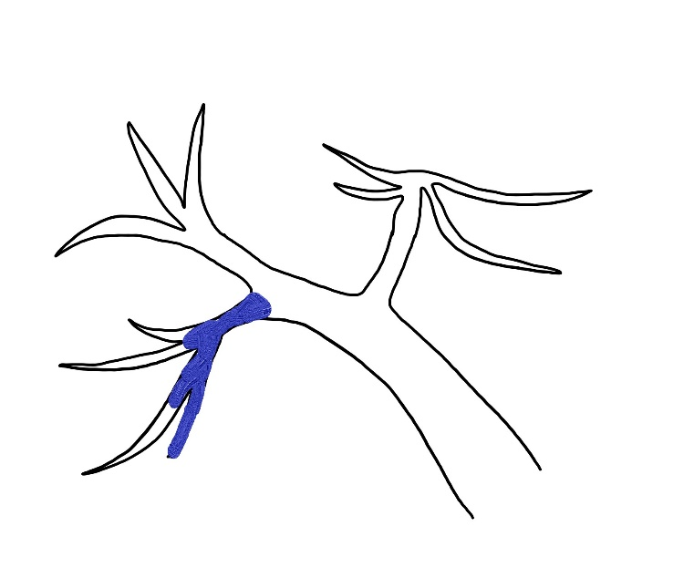
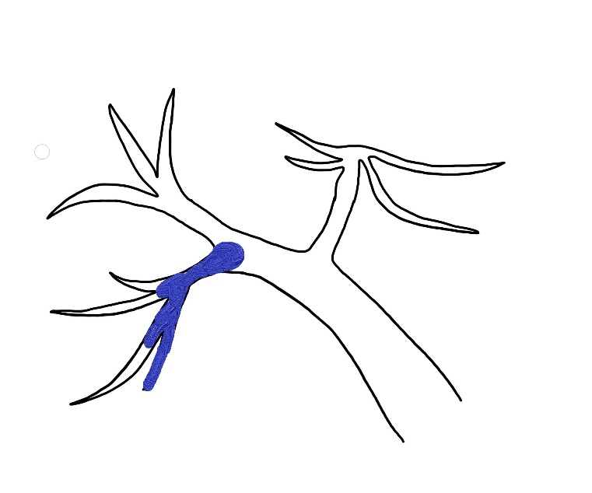
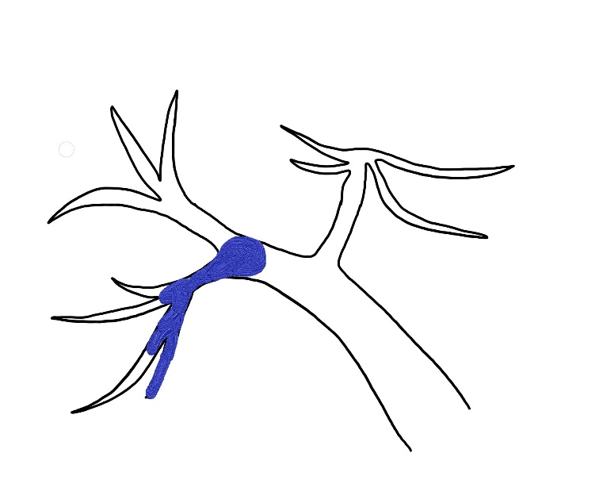
Vp1
Type 1
Vp2
Type 1
Vp2
Type 1
Vp2
Type 1
Vp3
Type 2
Vp3
Type 2

Slide 6
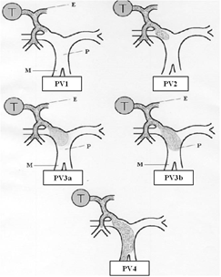
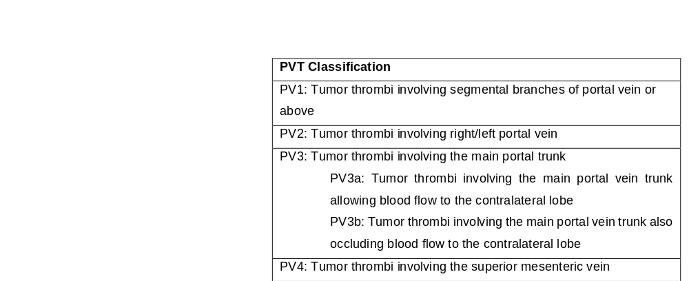
PVT classification
Shi J. et al. Ann Surg Oncol 2010;17:2073-80

Slide 7
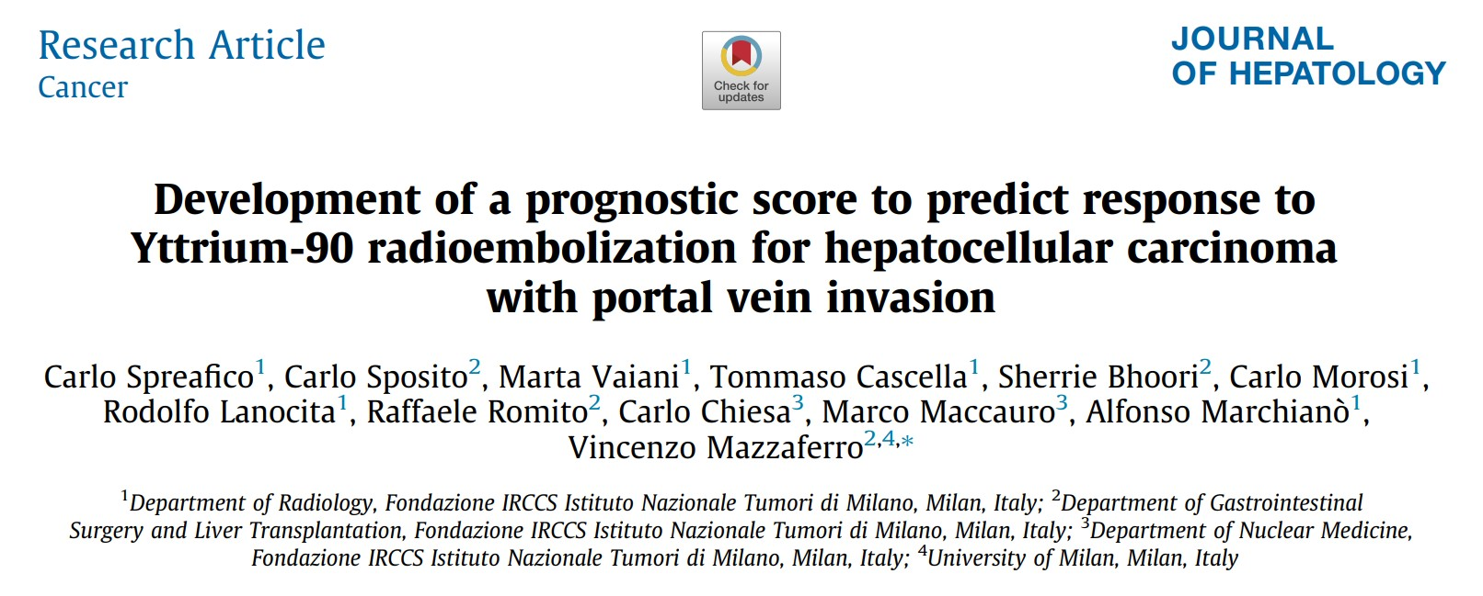
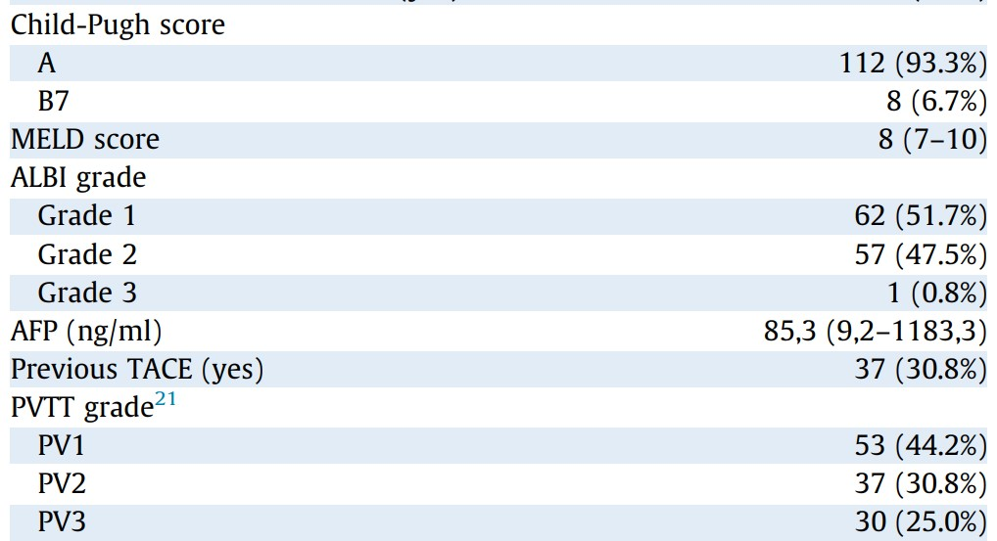
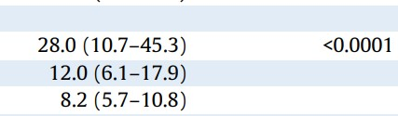

120명
대부분 Child-Pugh A

Slide 8
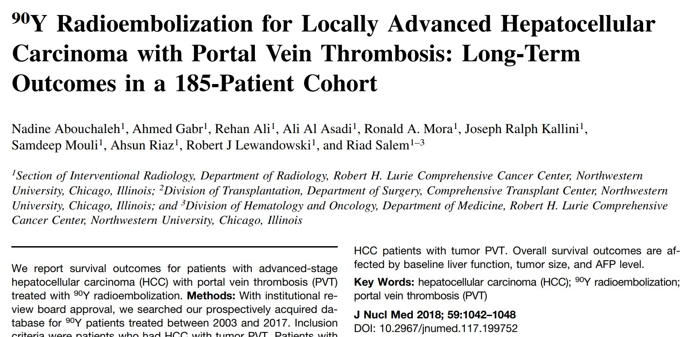
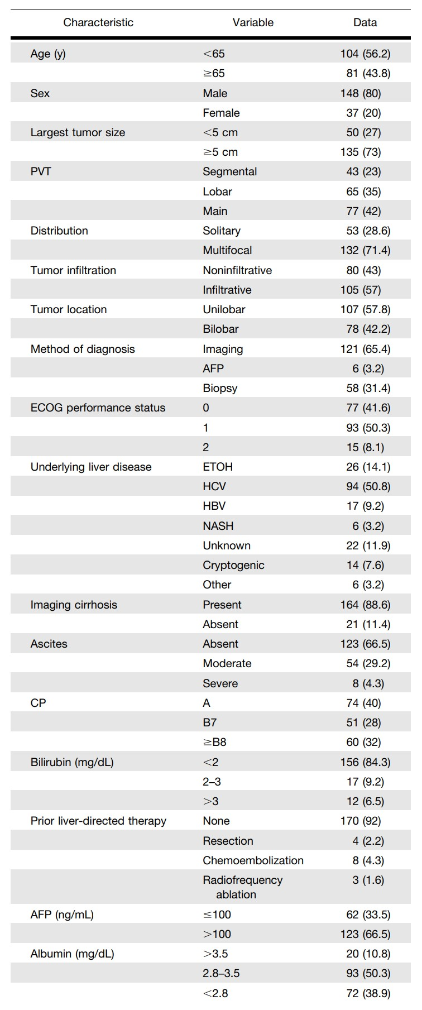

Slide 9
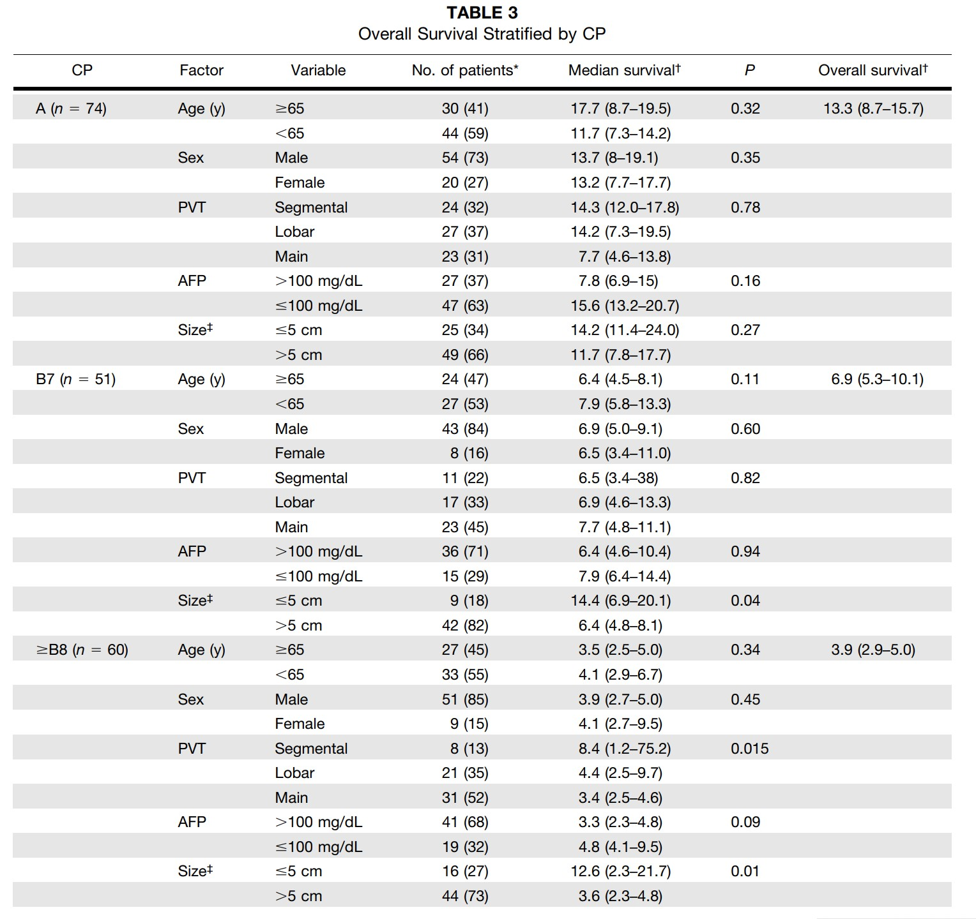

Slide 11
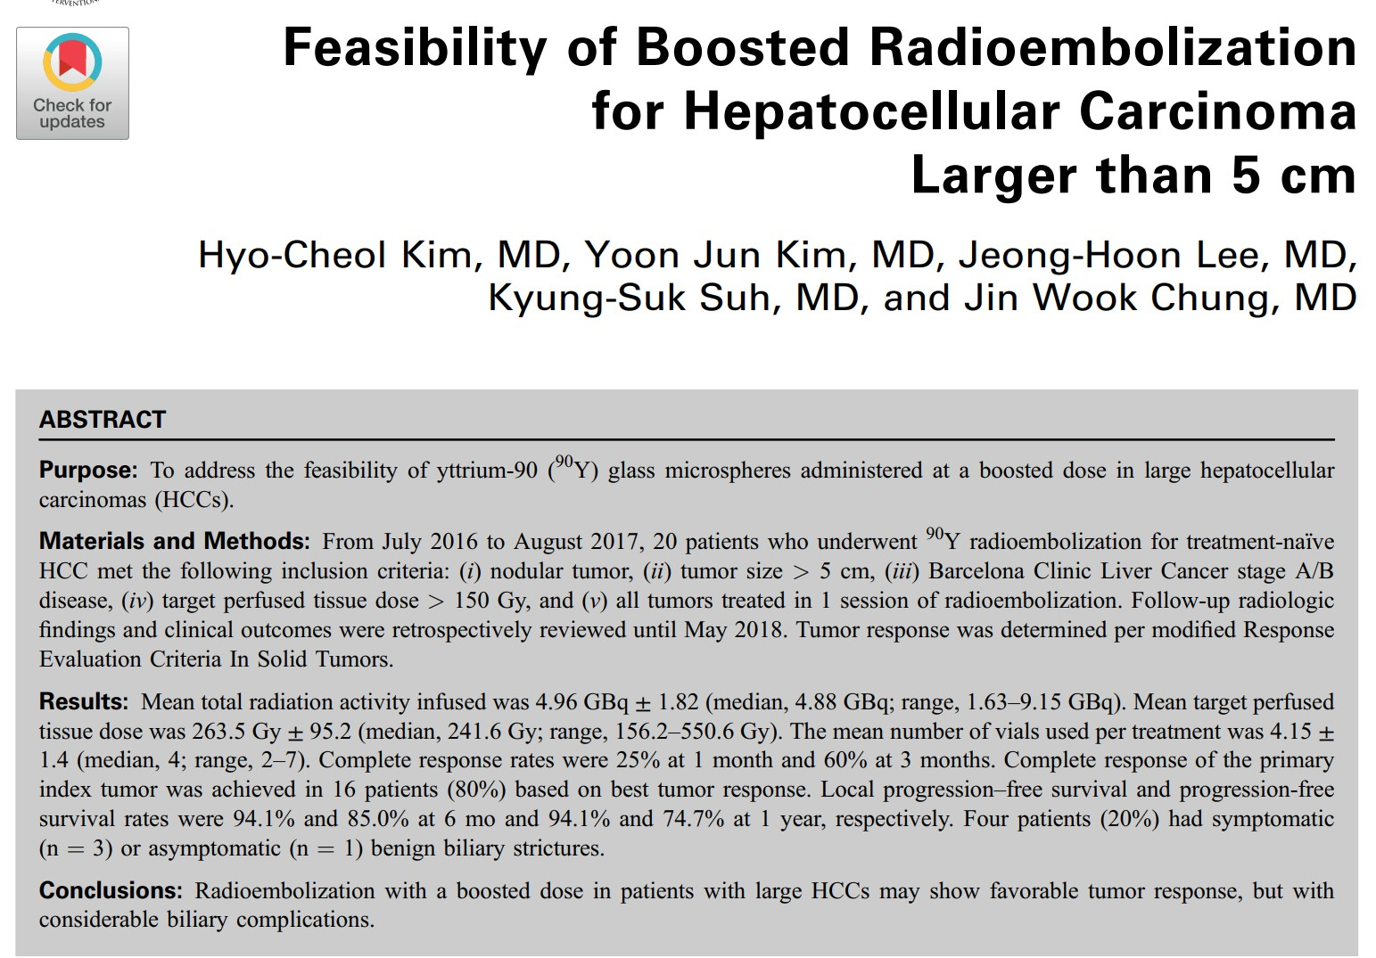
Standard dose = 120 Gy
Boosted dose > 150 Gy
JVIR 2019;30:1-8

Slide 12
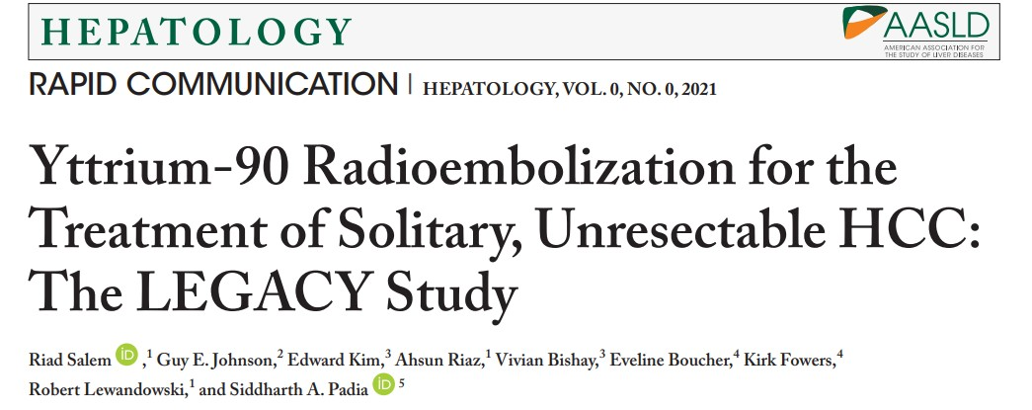
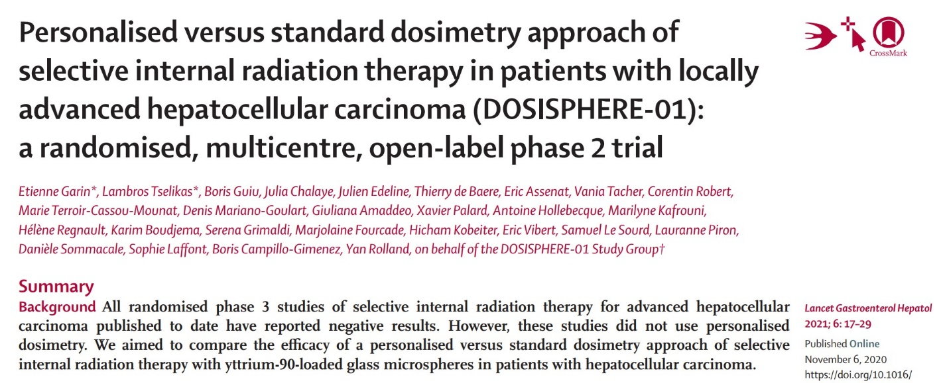
8cm 이하
Single tumor
→400Gy
→CR
Personalised dose
> 205Gy
→ Better outcome

Slide 13
Boosted radioembolization
Tumor with Minor PVT
  Low Tumor burden
  Localized tumor
  Unilobar disease
Sufficient normal liver can be saved.
Radiation segmentectomy/lobectomy
with short hospitalization, minimal pain, less visit
at the cost of high cost (800만원)

Slide 14
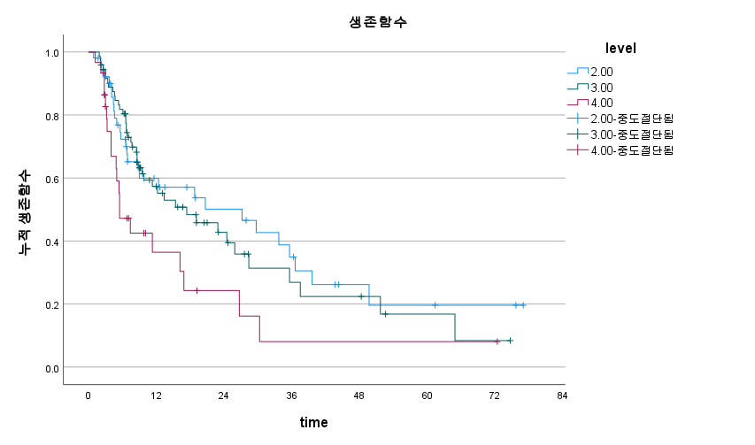
SNUH data (n = 155)
지난 10년간 treatment-naïve patient with PVT
Segmental 52명
Lobar 73명
Main 30명
Segmental 27.2 개월
Lobar 17.4개월
Main 5.5개월

Slide 15
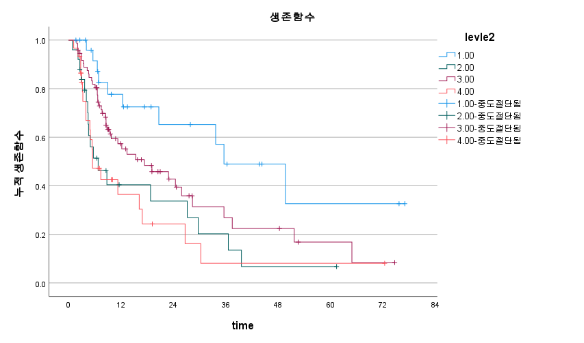
SNUH data (n = 155)
지난 10년간 treatment-naïve patient with PVT
Segmental 27명
RAPV, RPPV 25명
Lobar 73명
Main 30명
Segmental 35.6 개월
RAPV, RPPV 6.8 개월
Lobar 17.4개월
Main 5.5개월

Slide 16
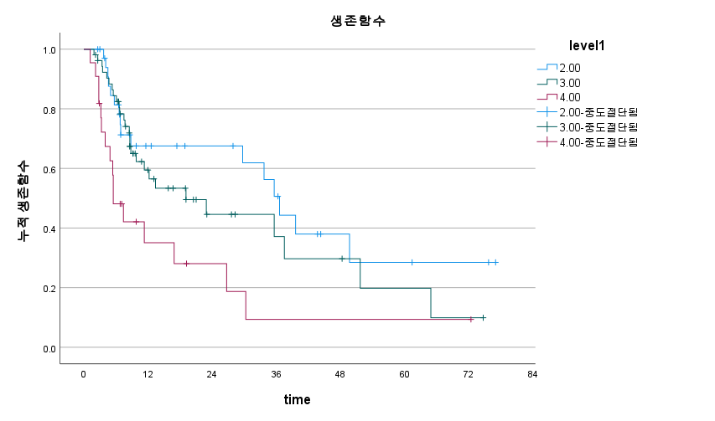
SNUH data (n = 110)
HV invasion, Bile duct invasion, extrahepatic meta 제외
Segmental 35명
Lobar 53명
Main 22명
Segmental 36.6 개월
Lobar 19.1개월
Main 5.5개월

Slide 17
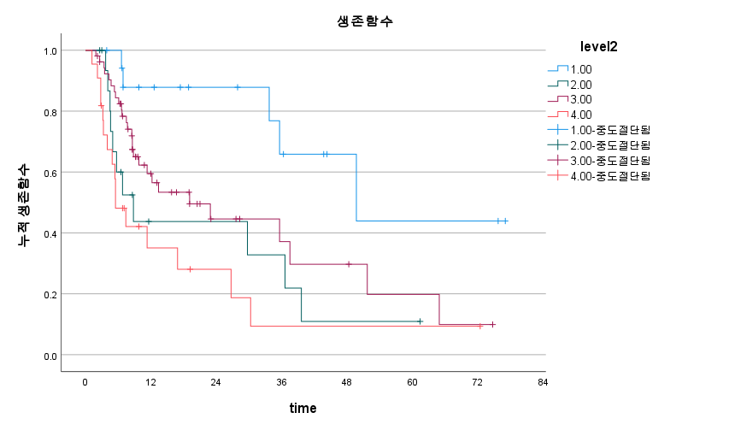
SNUH data (n = 110)
HV invasion, Bile duct invasion, extrahepatic meta 제외
Segmental 18명
RAPV, RPPV 17명
Lobar 53명
Main 22명
Segmental 49.7 개월
RAPV, RPPV 8.8 개월
Lobar 19.1개월
Main 5.5개월

Slide 18
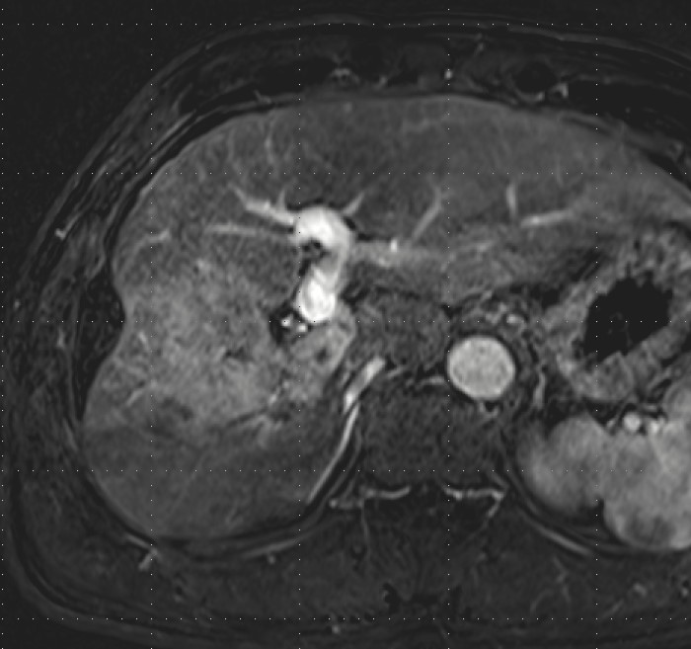
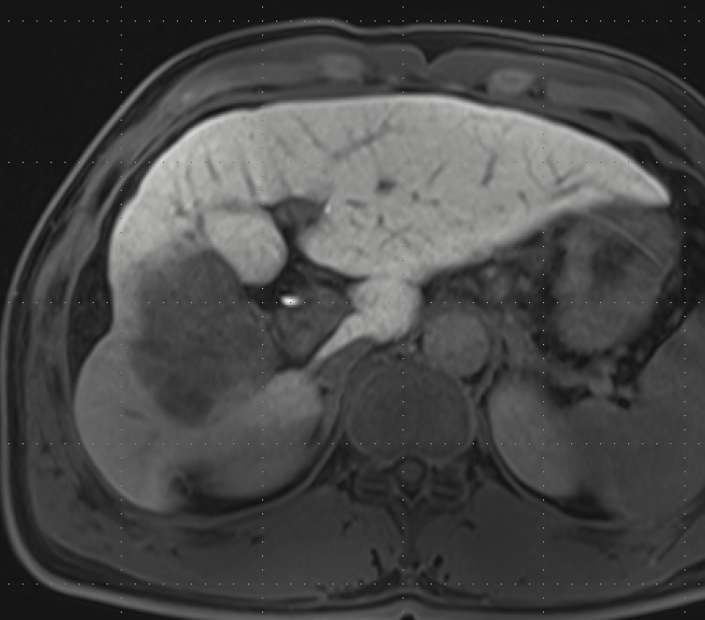
Locally advanced HCC with major PVI
7.5cm HCC with lobar PVT in Child-Pugh A5 ➔ TARE
TARE procedure : boosted dose in RH artery
prn half/regular dose in A4

Slide 19
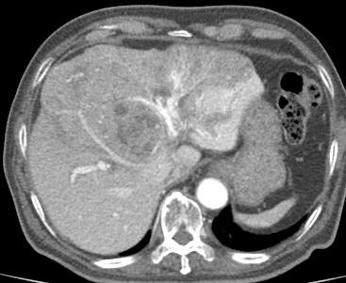
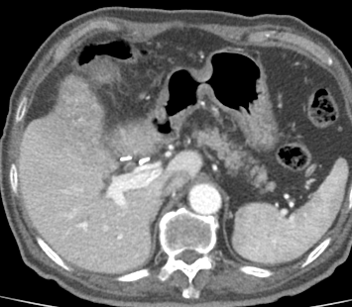
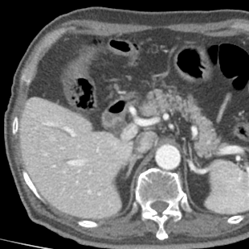
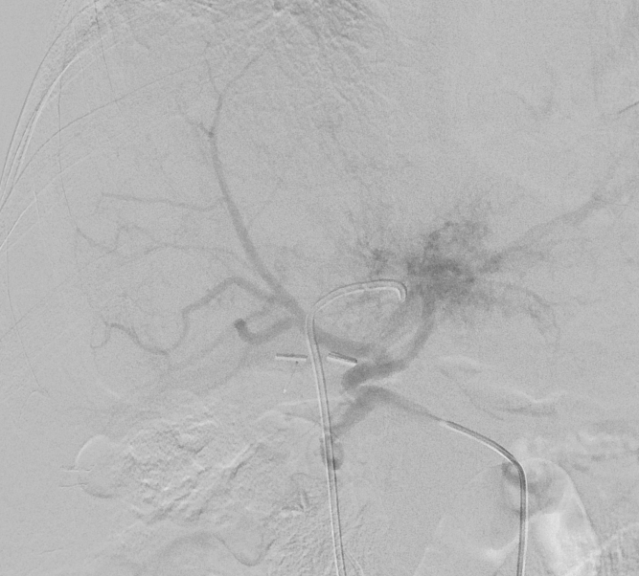
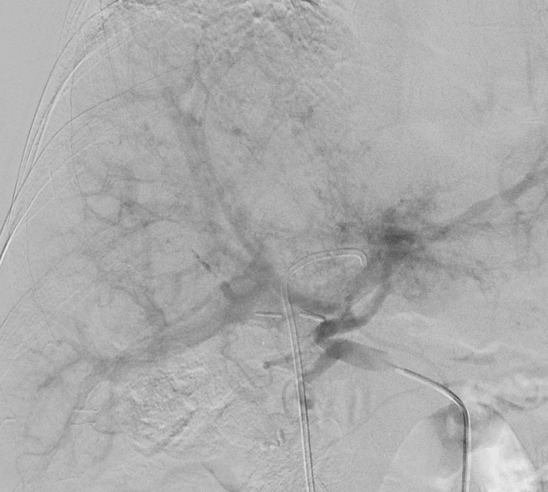
PVT with AP shunt
M/70, infiltrative HCC in left lobe, Lt PVT, AP shunt
Rt PV
Main PV
Arterial phase CT
Rt PV is brighter than main PV.
If Y-90 is injected into Lt HA, whole liver irradiation → REILD
Notes:
55410690 원정묵

Slide 20
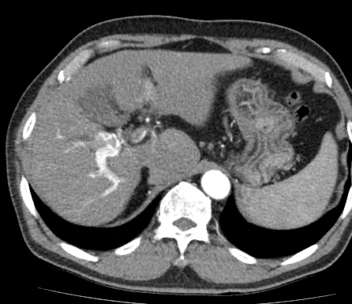
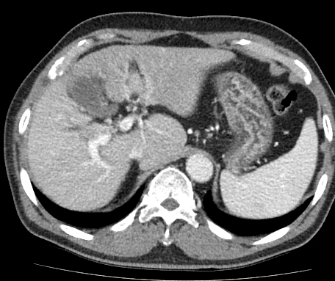
PVT with AP shunt
M/66, Infiltrative HCC with Lt PV & Rt ant portal vein thrombosis
Strong enhancement of right PV on arterial phase CT
TARE : risk of REILD because whole liver irradiation is inevitable.
→cTACE was performed.
Notes:
57442105 이 백

Slide 21
HCC with PVT
AP shunt : Absent vs Present
  Absent
    Good indication for TARE
  Present
    TARE is contraindicated when contralobar PV is enhanced on arterial phase CT
    cTACE + External RT may be effective.

Slide 22
Boosted radioembolization
Tumor with Major PVT
  Low Tumor burden
  Localized tumor
  Unilobar disease
Sufficient normal liver can be saved.
Radiation lobectomy
with short hospitalization, minimal pain, less visit
at the cost of high cost (800만원)

Slide 23
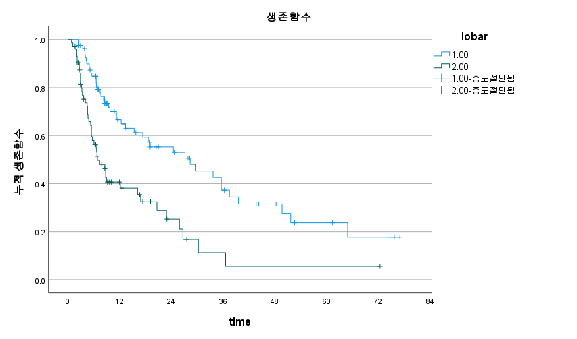
SNUH data (n = 155)
지난 10년간 treatment-naïve patient with PVT
Unilobar 82명
Bi-lobar 73명
Unilobar 28.4 개월
Bi-lobar 6.9 개월

Slide 24
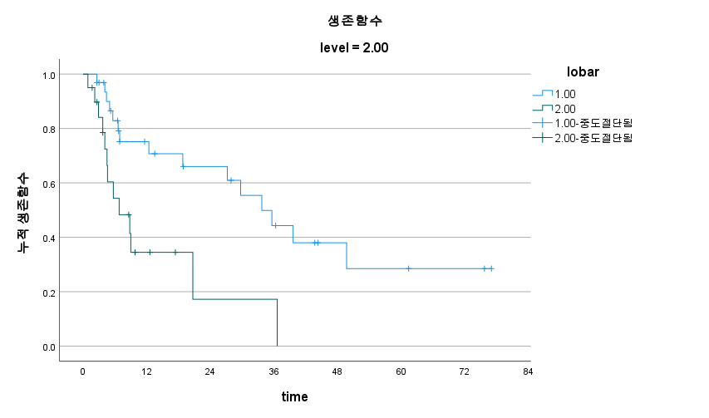
SNUH data (n = 155)
지난 10년간 treatment-naïve patient with PVT
Segmental PVT 52명
Unilobar 32명
Bi-lobar 20명
Unilobar 33.7 개월
Bi-lobar 6.8 개월

Slide 25
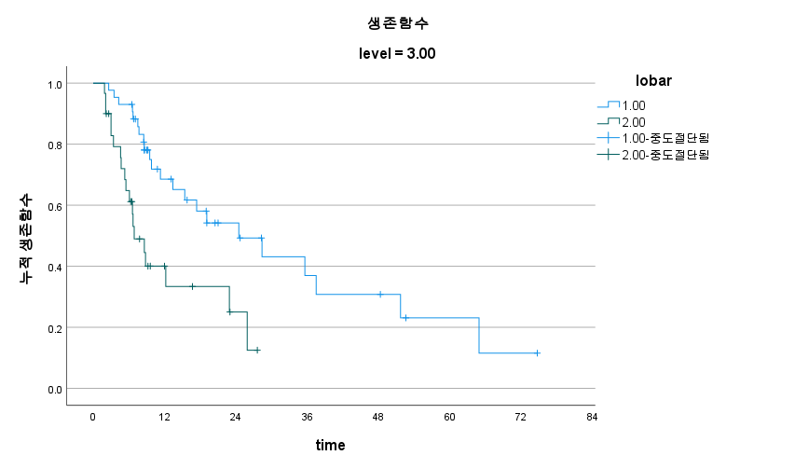
SNUH data (n = 155)
지난 10년간 treatment-naïve patient with PVT
Lobar PVT 73명
Unilobar 43명
Bi-lobar 30명
Unilobar 24.5 개월
Bi-lobar 6.9 개월

Slide 26
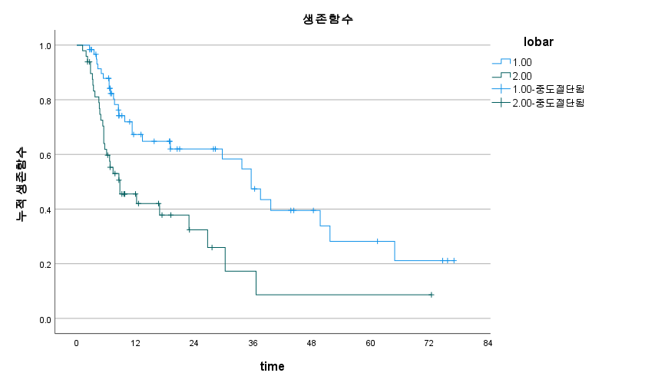
SNUH data (n = 110)
HV invasion, Bile duct invasion, extrahepatic meta 제외
Unilobar 61명
Bi-lobar 49명
Unilobar 35.6 개월
Bi-lobar 8.8 개월

Slide 27
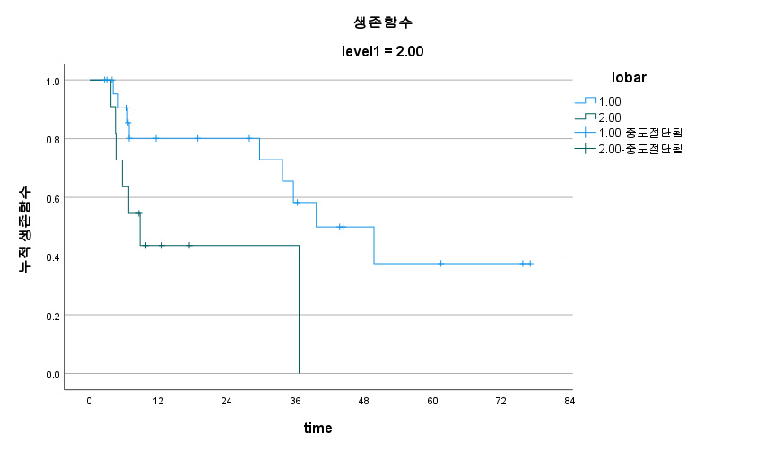
SNUH data (n = 110)
HV invasion, Bile duct invasion, extrahepatic meta 제외
Segmental PVT 35명
Unilobar 24명
Bi-lobar 11명
Unilobar 39.6 개월
Bi-lobar 8.8 개월

Slide 28
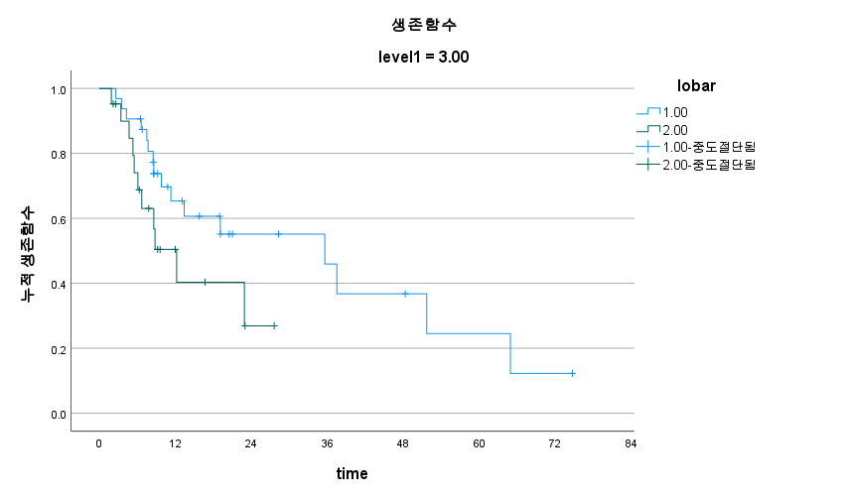
SNUH data (n = 110)
HV invasion, Bile duct invasion, extrahepatic meta 제외
Lobar PVT 53명
Unilobar 32명
Bi-lobar 21명
Unilobar 35.6 개월
Bi-lobar 12.2 개월

Slide 29
HCC with PVT
Liver function : Child class A
Tumor extent : Uni-lobar disease
AP shunt : Absent
→ Boosted radioembolization is feasible
→ Good clinical outcome is expected.

Slide 30
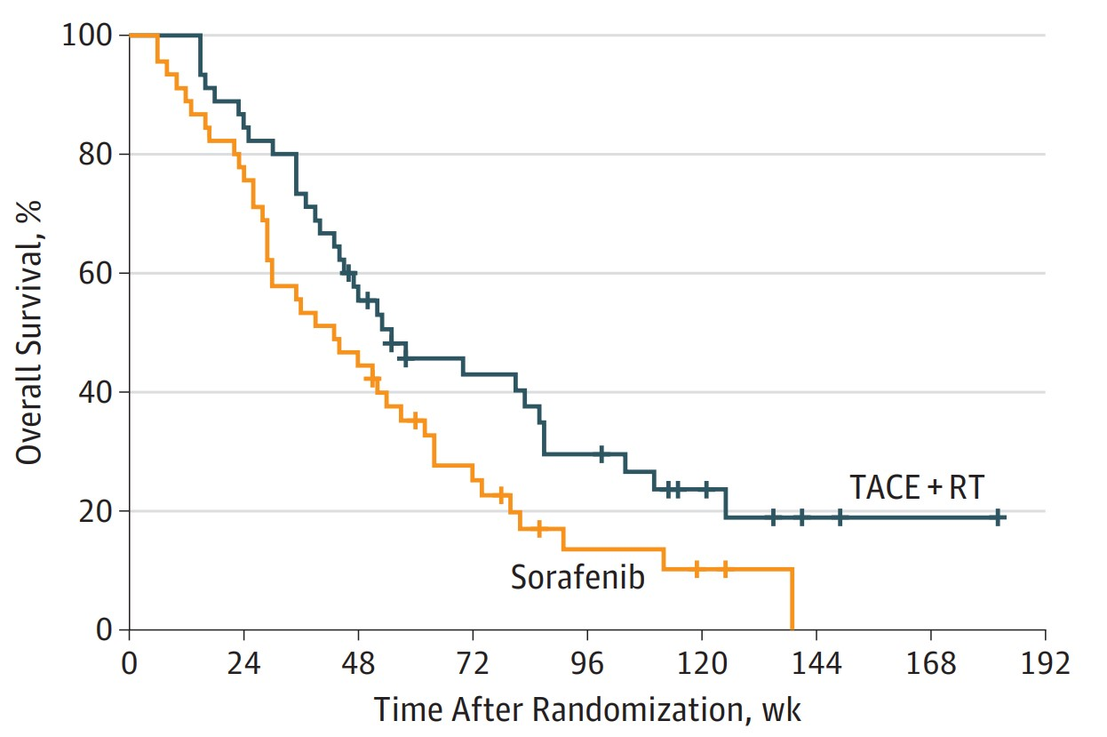
JAMA oncology
Unilateral (61.1%) + Main (38.9%) PVT
TACE +RT 55.0 주
Sorafenib 43.0 주

Slide 31
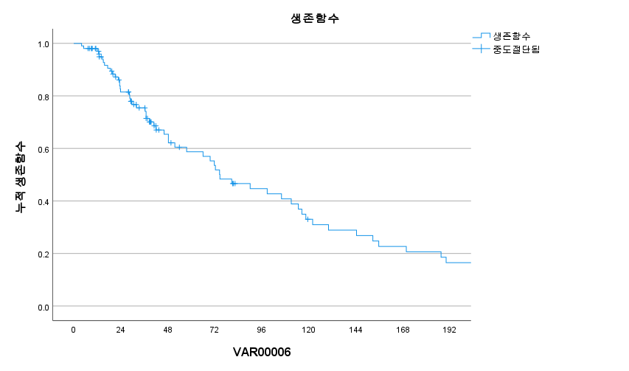
SNUH data (n = 103)
Lobar (73) + Main (30) PVT
TARE 74.6 주
17.2개월

Slide 32
TARE vs TACE+RT vs Sorafenib
TARE 74.6 주
TACE +RT 55.0 주
Sorafenib 43.0 주

